Slide 1

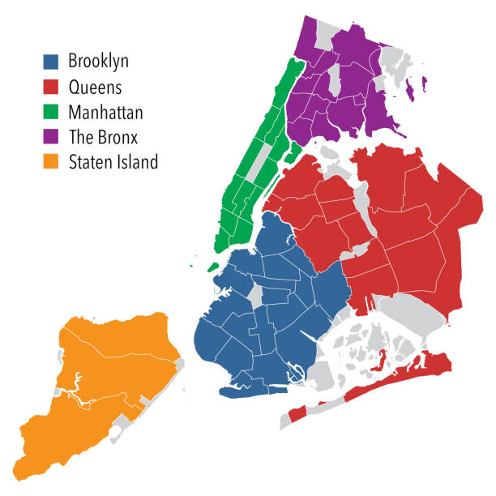
AMS 597: STATISTICAL COMPUTING PROJECT
NYC Crime Report Analysis in R
Group 1:-
Varshaa Sai Sripriya Saisheshadhri, 116732152
Swati Swati, 116778659
Dhruv Rathee, 116633028
Kabir Manoj Ohekar, 116793038
Iftekhar Alam, 113269424

Slide 2

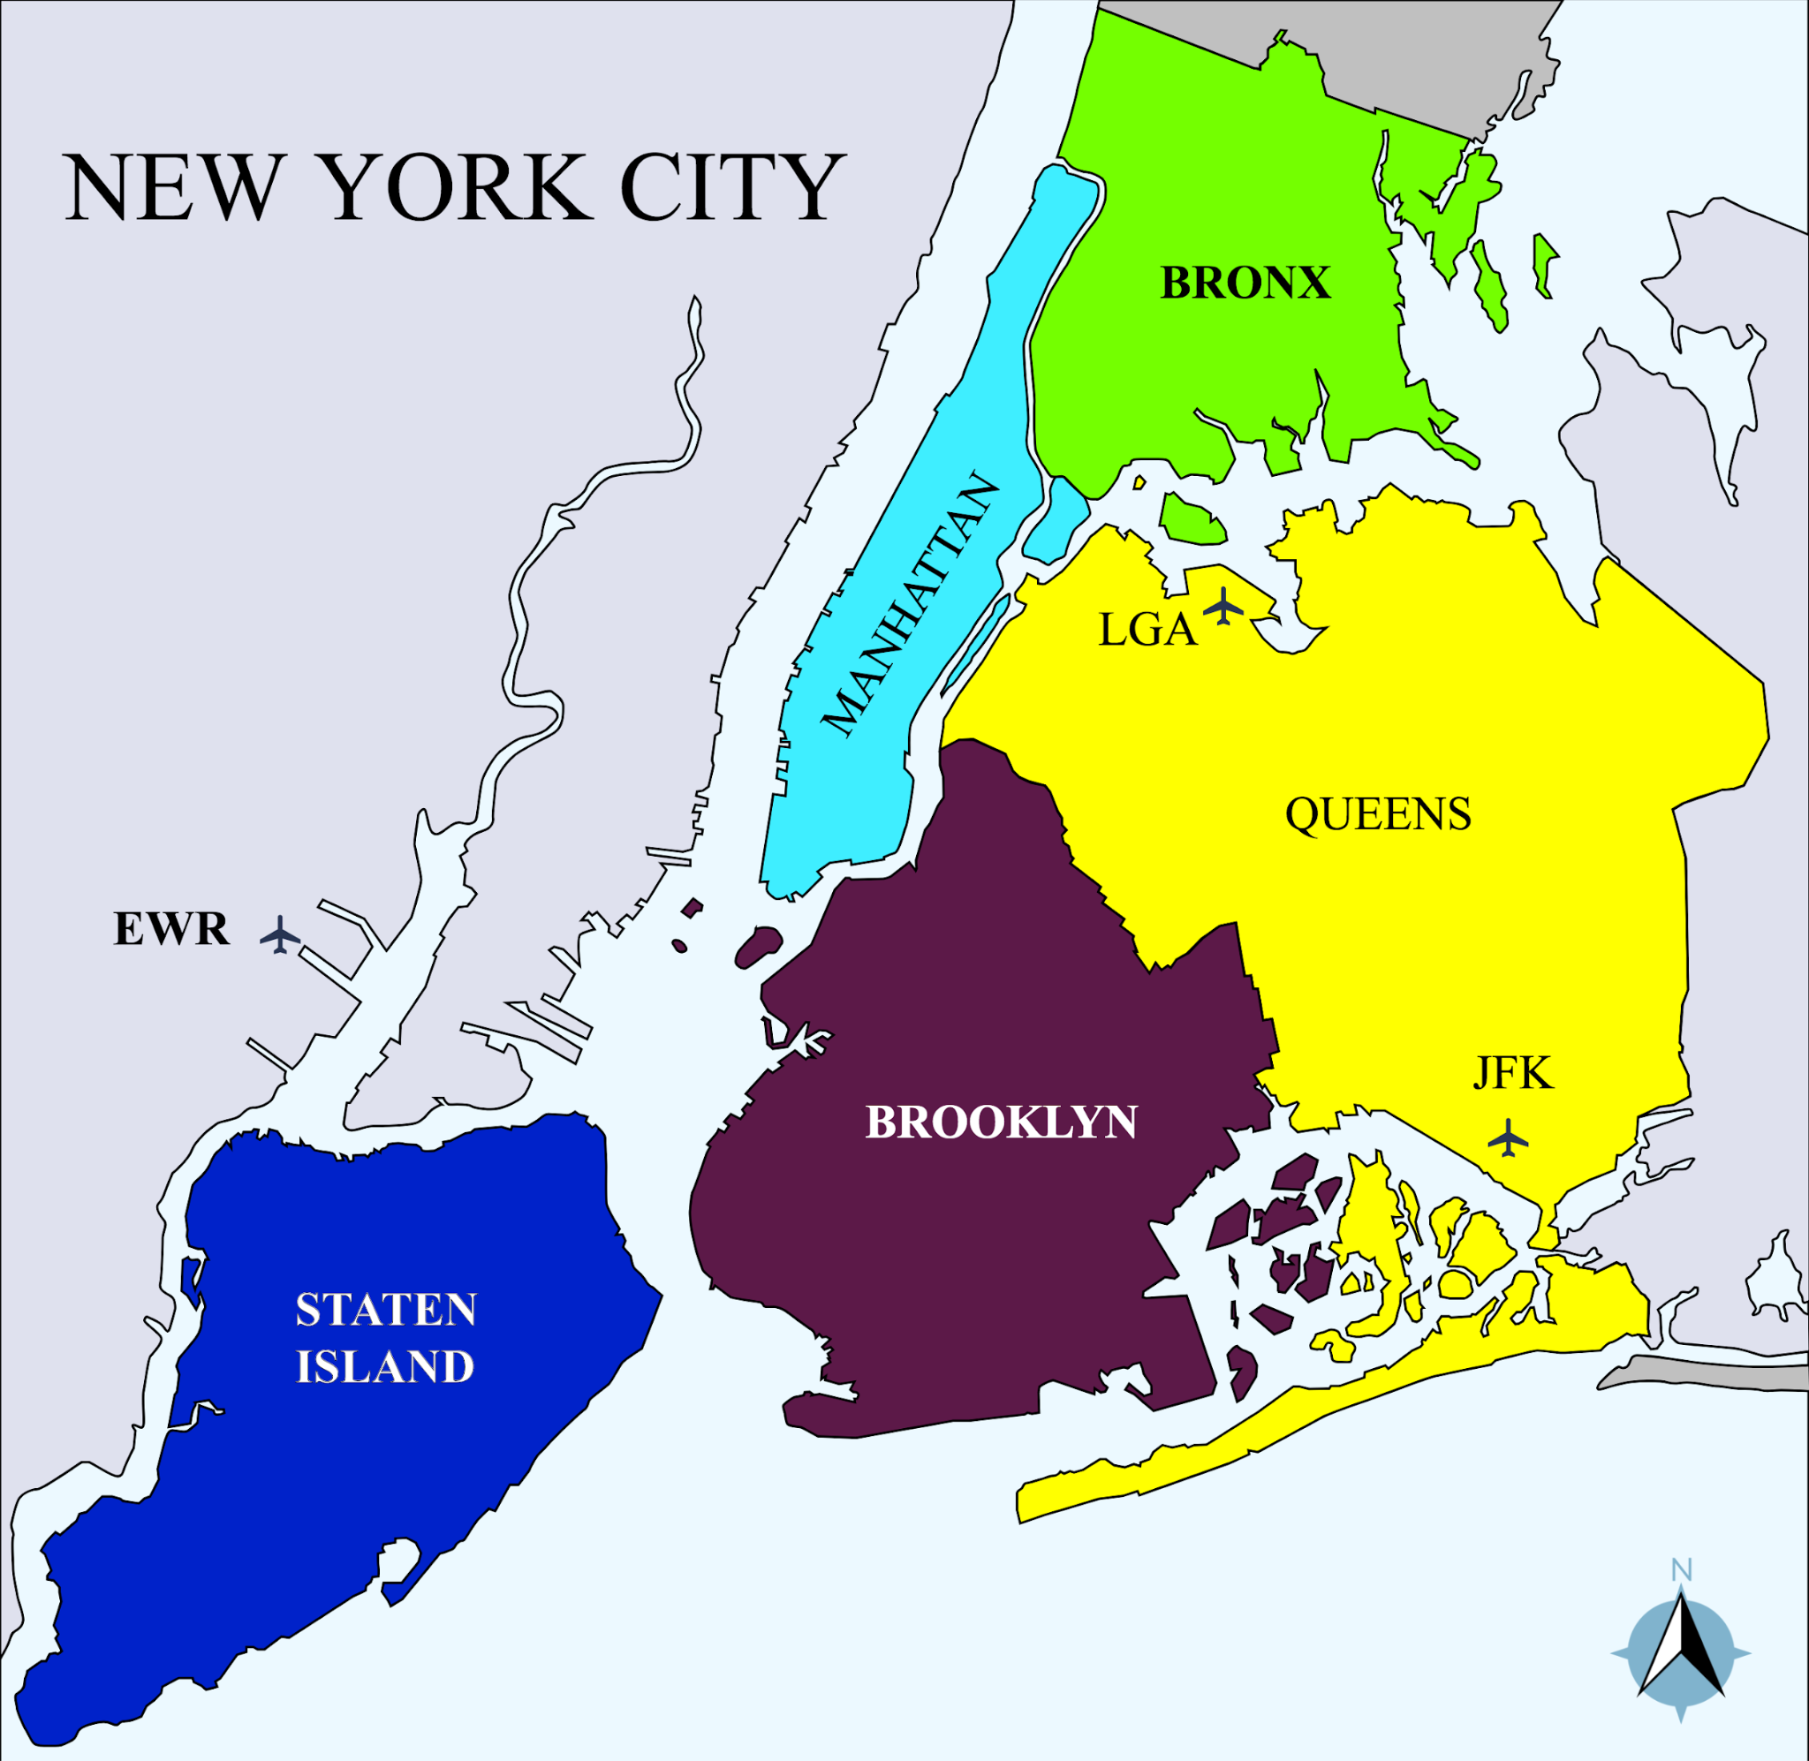

INTRODUCTION
1. Importance of Crime Data in Life Decisions
Crime statistics help individuals make informed choices about where to live, travel, or invest by quantifying risk in different environments.
2. New York City as a Diverse Case Study
NYC’s five boroughs offer a dynamic landscape to explore how crime patterns correlate with neighborhood character, socioeconomics, and public policy.
3. Analytical Power of R in Crime Research
R enables advanced crime data analysis—using tools like multivariate modeling, geospatial clustering, and forecasting—to uncover deep insights that guide public safety efforts.

Slide 3
DATASET DESCRIPTION
The dataset covers validated crime reports (felonies, misdemeanors, violations) from 2006–2016 across NYC’s five boroughs and precincts, with both real-time and historical data containing 300K+ records. (Source: https://data.world/data-society/nyc-crime-data)
DATE/TIME ATTRIBUTES
NUMERICAL ATTRIBUTES
CATEGORICAL ATTRIBUTES
Attribute | Description
CMPLNT_FR_DT | Start date of occurrence
CMPLNT_FR_TM | Start time of occurrence
CMPLNT_TO_DT | End date of occurrence
CMPLNT_TO_TM | End time of occurrence
RPT_DT | Date when the event was reported
Attribute | Description
CMPLNT_NUM | Persistent numeric ID for each complaint
KY_CD | Three-digit offense classification code
PD_CD | Three-digit internal classification code
ADDR_PCT_CD | Precinct code where the incident occurred
X_COORD_CD | X-coordinate (NY State Plane Coordinate System)
Y_COORD_CD | Y-coordinate (NY State Plane Coordinate System)
Latitude | Latitude in decimal degrees
Longitude | Longitude in decimal degrees
Lat Lon | Tuple of Latitude and Longitude
Attribute | Description
OFNS_DESC | Description of offense
PD_DESC | Description of internal classification
CRM_ATPT_CPTD_CD | Attempted vs Completed indicator
LAW_CAT_CD | Level of offense: Felony, Misdemeanor, Violation
JURIS_DESC | Jurisdiction responsible
BORO_NM | Borough name
LOC_OF_OCCUR_DESC | Location relative to premises
PREM_TYP_DESC | Premises type
PARKS_NM | Name of park
HADEVELOPT | Name of housing development

Slide 4
Background
Some relevant Papers used as reference
Study | Methodology | Key Insights | Relevance
Kumar et al. (2024) | Random Forest, K-Means | Identified spatial-temporal patterns across boroughs | Baseline for borough-specific crime classification
Almuhanna et al. (2021) | XGBoost vs. SVM/RF | XGBoost achieved 52% accuracy for multi-class crime prediction | Highlights model superiority for NYC’s diverse boroughs
Sharma et al. (2023) | PCA + Random Forest | 60% accuracy in Boston crime prediction | Supports feature engineering for urban crime models
Zhang et al. (2020) | LSTM | 57.6% hotspot accuracy; spatial > temporal patterns | Validates geospatial focus for NYC
Kadar et al. (2018) | Foursquare venue data correlation | Entertainment/food check-ins linked to crime types | Borough-specific predictive features
Olowole (2022) | LSTM + weather variables | RMSE: 88.27 for weather-influenced crime | Temporal modeling with external factors
Safat et al. (2021) | XGBoost | 94% accuracy (Chicago) vs. 88% (LA) | Emphasizes need for borough-specific tuning
Kshatri et al. (2021) | Stacked ensemble (SVM meta) | 99.5% accuracy for Indian crime data | Suggests ensemble methods for NYC
Mary Shermila (2018) | Neural Networks | 96–97% accuracy for perpetrator demographics | Potential for NYC suspect profiling
Gupta et al. (2024) | Hybrid Deep Learning | High accuracy in proactive crime detection | Framework for smart surveillance in NYC
Key Takeaways:
1. Model Performance: XGBoost/ensembles outperform for multi-class prediction.
2. Spatial Focus: Geospatial features (venue data, coordinates) critical for NYC.
3. Temporal: LSTM/ARIMA effective for time-series crime patterns.
4. Borough Variability: Models require localized tuning
5. Ensemble methods such as Random Forest provide best performance along with hybrid models compared to standalone models.

Slide 5

Research Questions
Question 1:
How well does the decision tree model generalize to unseen data, and what performance metrics support its reliability in borough classification?
Question 2:
How do ensemble methods compare to traditional classifiers in terms of accuracy and generalization performance?
Question 3:
How effective is a Random Forest model in predicting categorical geographic attributes (e.g., borough names) based on temporal and categorical features in a large-scale urban crime dataset?

Slide 6
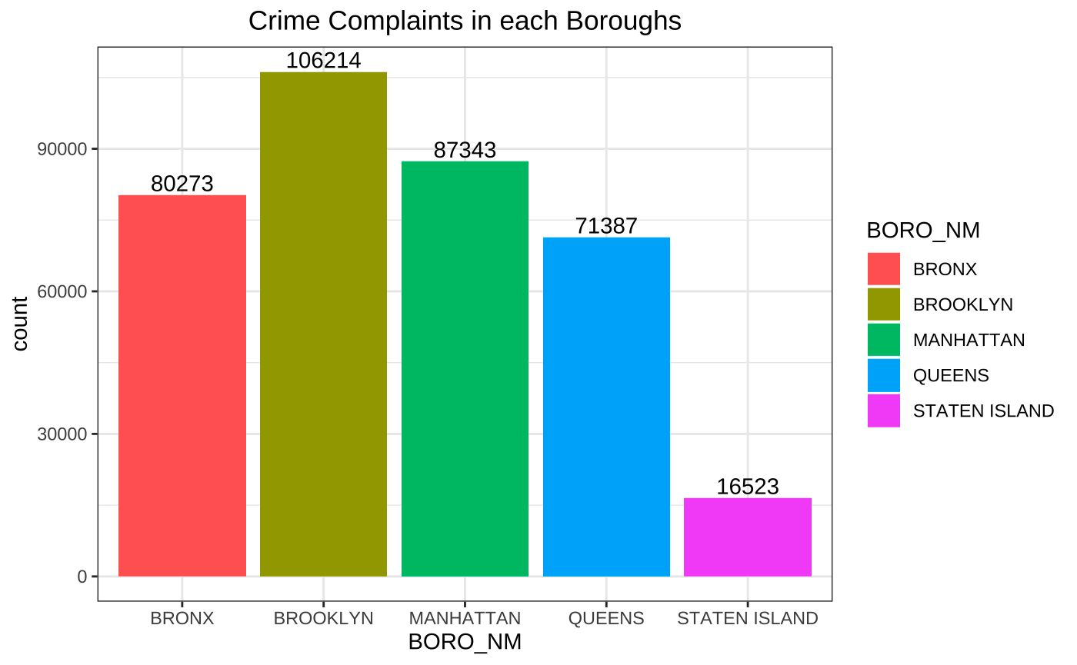
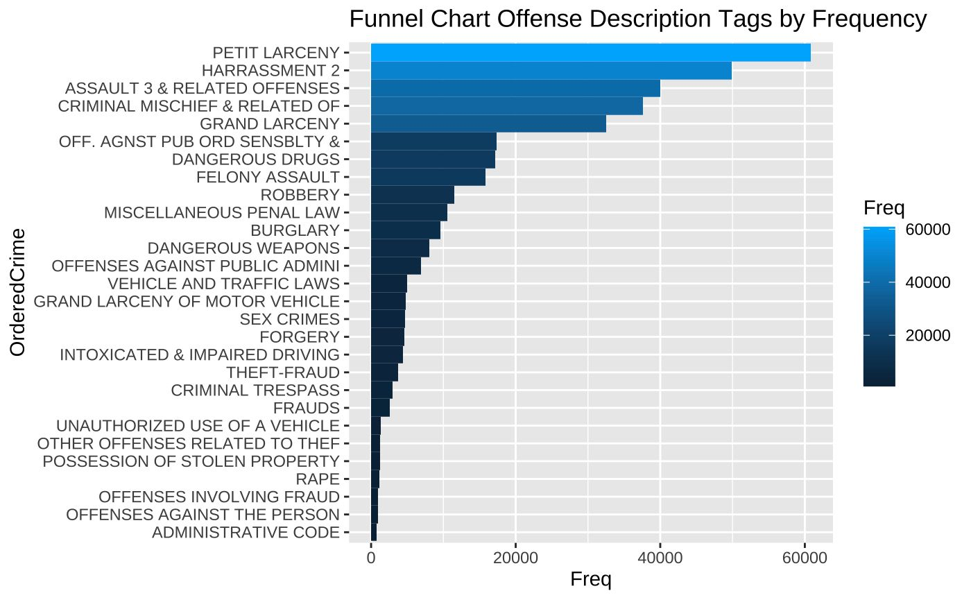
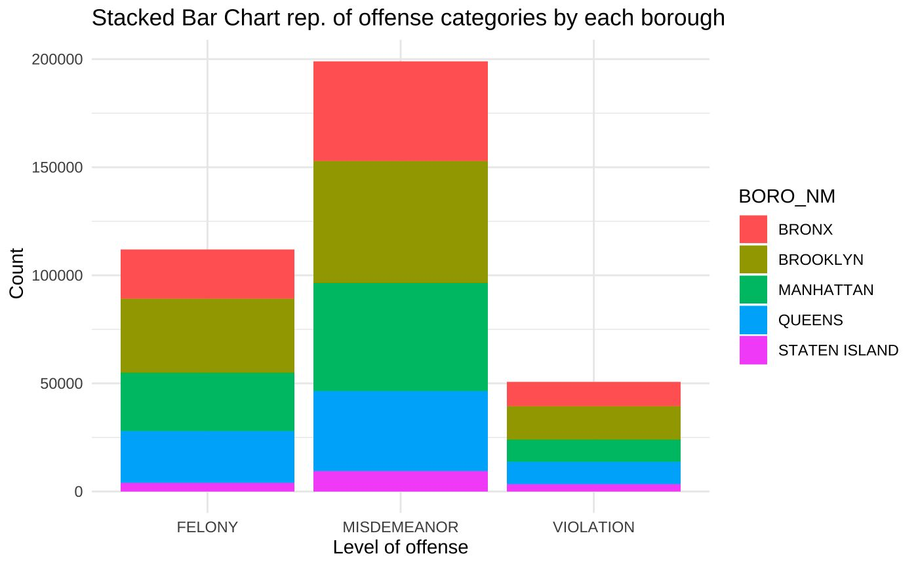
EXPLORATORY DATA ANALYSIS
Key Highlights from the charts:
📍 Brooklyn reports the highest crime complaints (~106K), followed by Manhattan and Bronx.
📊 Misdemeanors are the most common offense type across all boroughs.
🔍 Top offenses include Petit Larceny, Harassment, and Assault.
🧩 Theft-related crimes dominate the dataset.
🌆 Staten Island shows significantly lower crime rates compared to other boroughs.

Slide 7

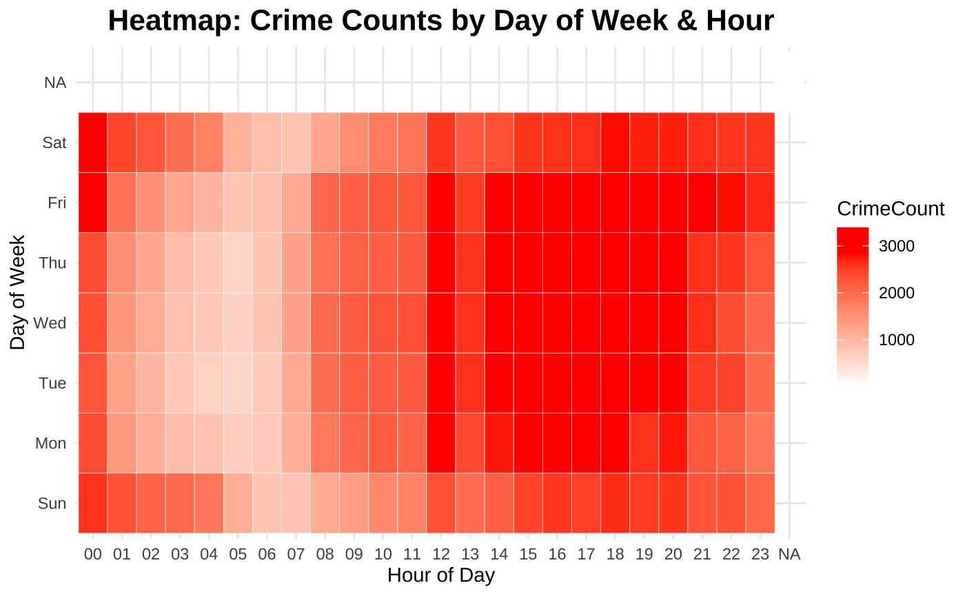
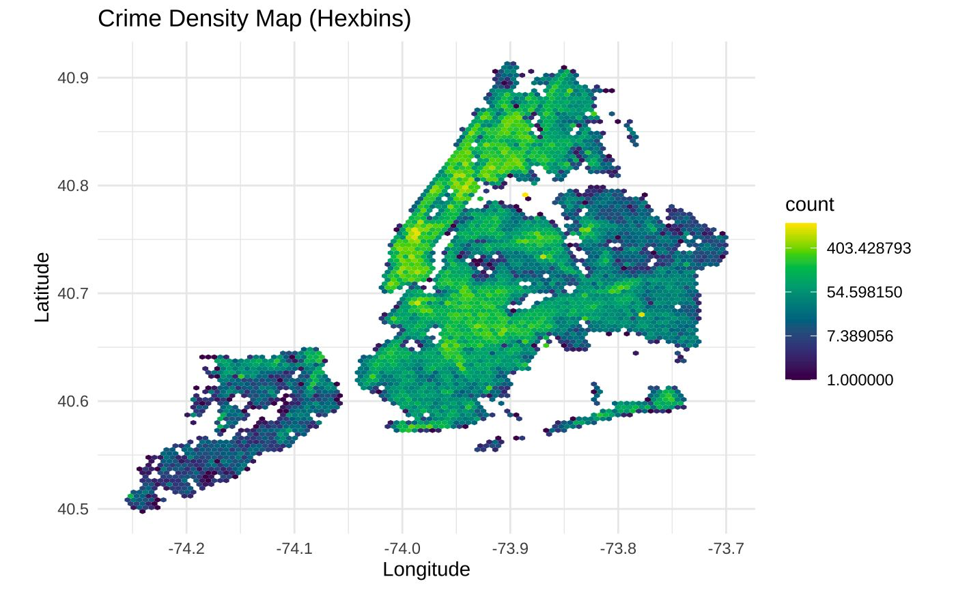
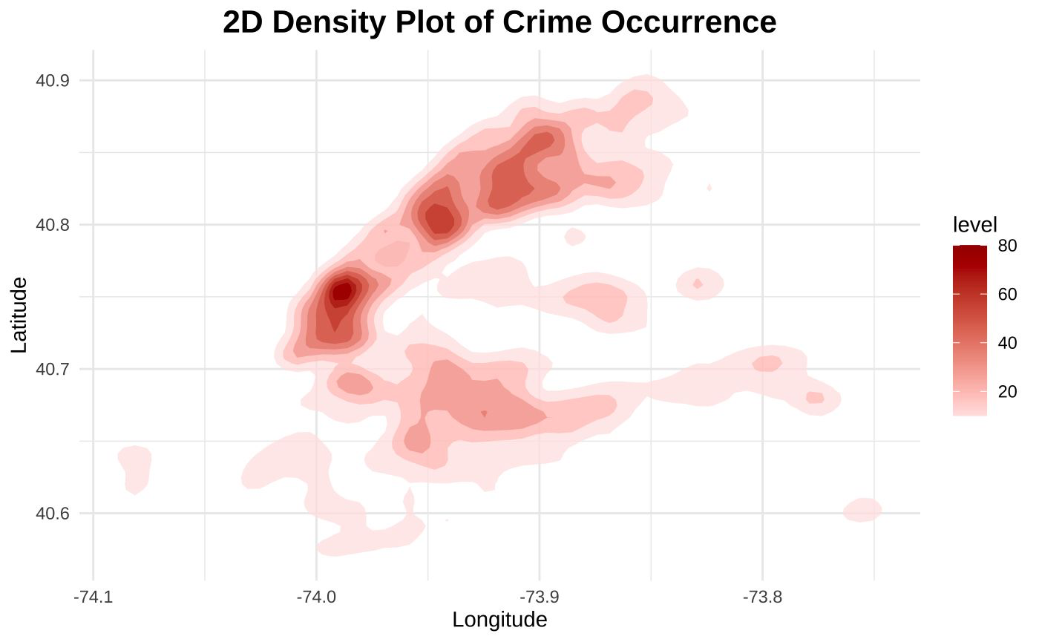
EXPLORATORY DATA ANALYSIS
Key Highlights:
⏰ Crime activity peaks between 12 PM and 8 PM, especially on Fridays and Saturdays.
🔍 Lowest crime counts occur during early morning hours across all days.
🗺️ Crime is most concentrated in central and southern Manhattan based on density plots.
📍 High crime clusters also appear in Brooklyn and the Bronx, as shown in the hexbin map.
🧭 Spatial analysis reveals clear urban crime hotspots for targeted safety strategies.

Slide 8
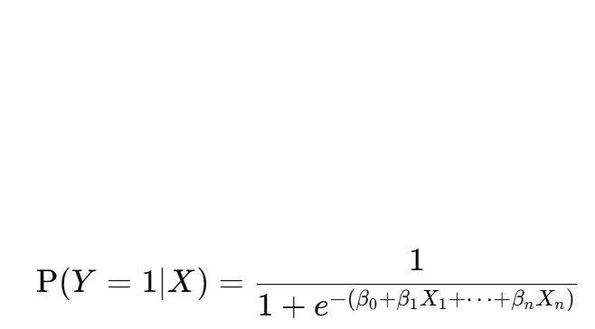
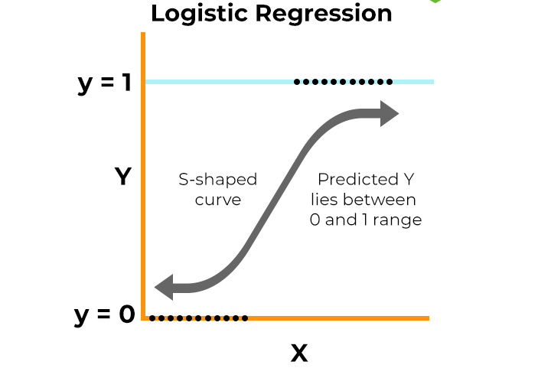
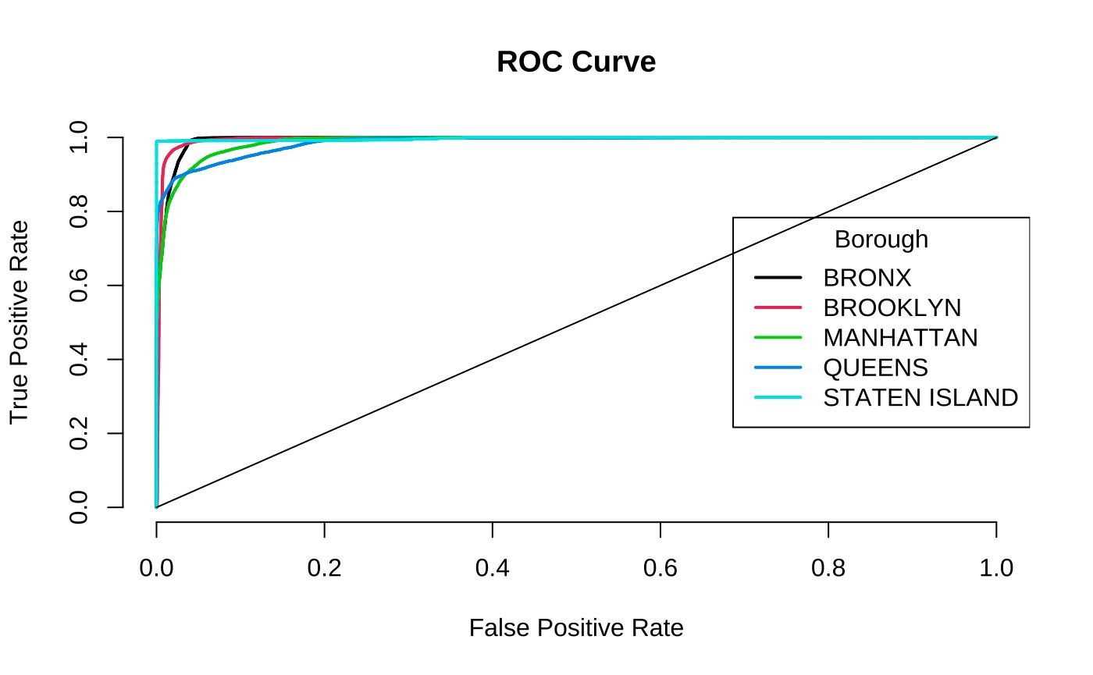

Model Training & Results
Logistic Regression, KNN, Decision Tree, SVM, Random Forest,
Logistic Regression
Results
Used for binary or multi-class classification.
Predicts probability of class membership using a sigmoid function.
Suitable for linearly separable classes.
Train Accuracy | 92.05%
Test Accuracy | 92.17%
Runtime | Low
Objective: Maximize likelihood (MLE) of predicting correct class.
Consistent Model Performance: TPR increases steadily (0.2 → 1) across all boroughs
No overfitting: Smooth TPR, progression i.e. consistency across boroughs, diverse data coverage
Fair performance across regions
Effective sensitivity control
Generalizable to new data
Statistical Insights
Assumes linear relationship between features and log-odds.
Low variance, moderate bias—good generalization.
Interpretable coefficients

Slide 9
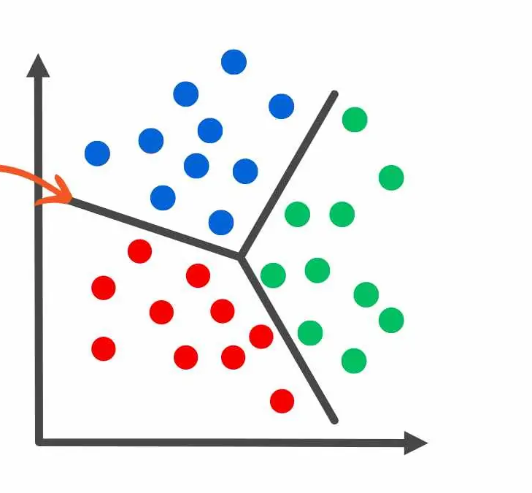
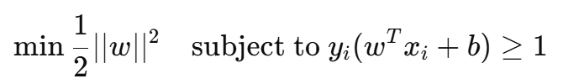
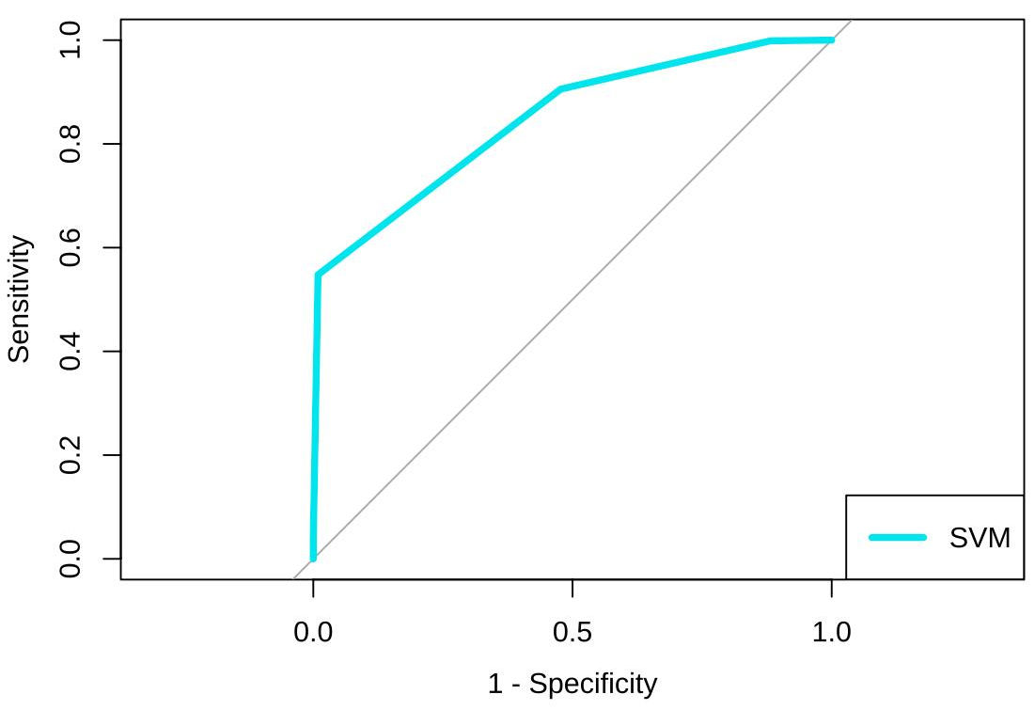
Model Training & Results
Logistic Regression, KNN, Decision Tree, SVM, Random Forest,
Support Vector Machine
Results
Maximizes the margin between classes using hyperplanes.
Powerful for high-dimensional datasets.
Kernel trick allows non-linear decision boundaries
Train Accuracy | 70.46%
Test Accuracy | 66.99%
Runtime | Com
Underwhelming accuracy suggests the model may not be optimal for this dataset.
Potentially underfitting, possibly due to noise, overlap in classes, or unsuitable kernel.
Computationally expensive with marginal returns—may not scale well for large crime datasets.
Non-ideal performance
Fair classification ability
Statistical Insights
Low bias, high variance model.
Very effective with tuning (kernel, C, gamma).
Requires scaling..

Slide 10
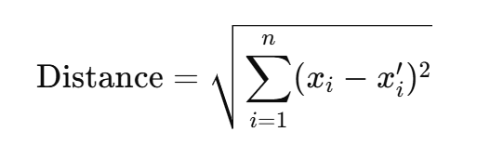
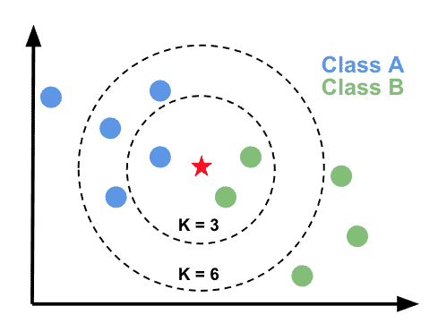
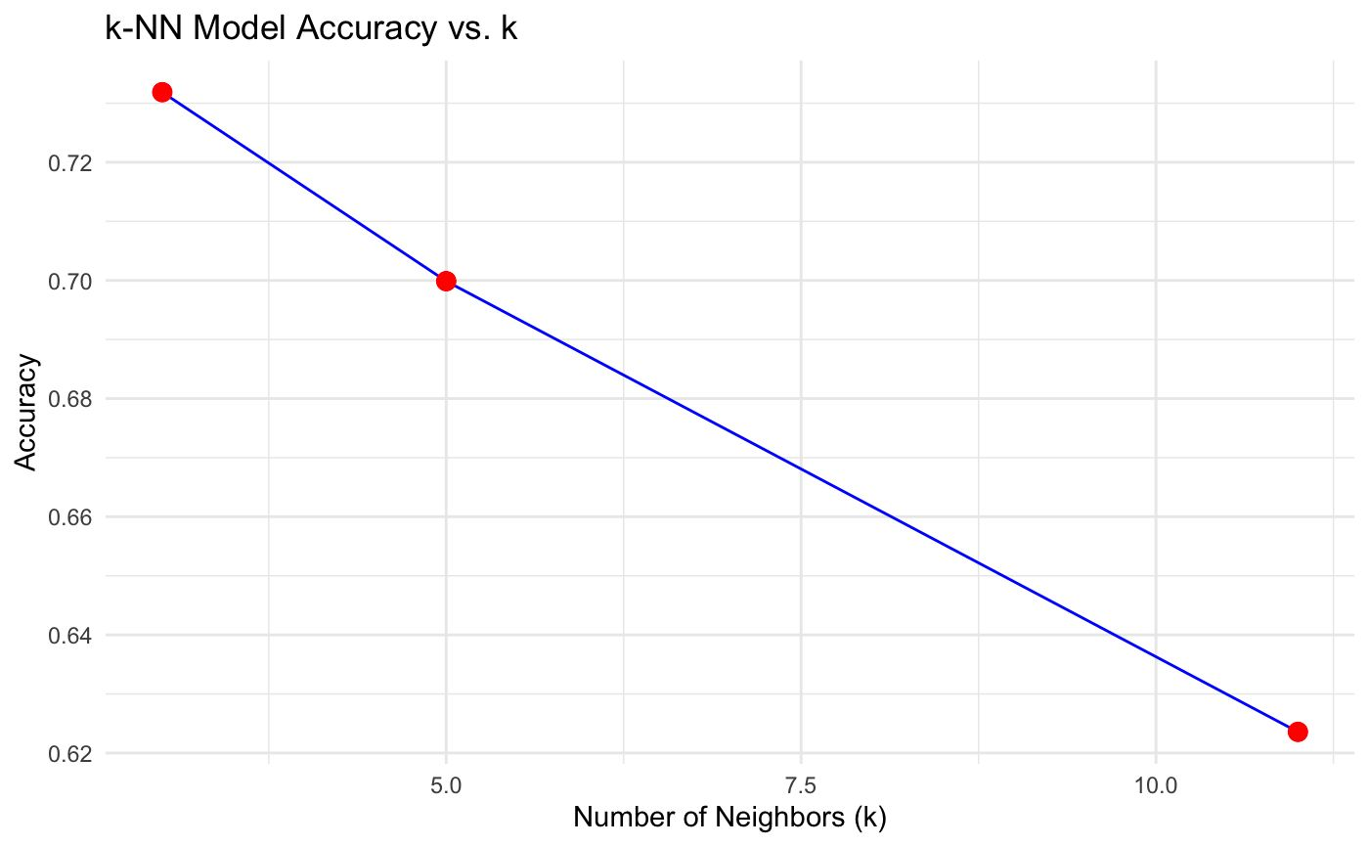
Model Training & Results
Logistic Regression, KNN, Decision Tree, SVM, Random Forest,
K Nearest Neighbors
Results
Instance-based (lazy learning) algorithm.
Classifies based on majority vote of 'k' nearest neighbors.
No training time, but prediction can be slow.
Train/ Test Accuracy | 73.28%
Runtime | Moderate
Uses Euclidean distance metrics.
Lower accuracy and potential underfitting with high k-values.
Lower Accuracy → weaker predictive performance
Risk of over-smoothing
Moderate runtime – lazy learning
Curse of Dimensionality
Statistical Insights
High variance, low bias model.
Over-smoothing occurs if k is too large.
Sensitive to irrelevant features & scale.

Slide 11
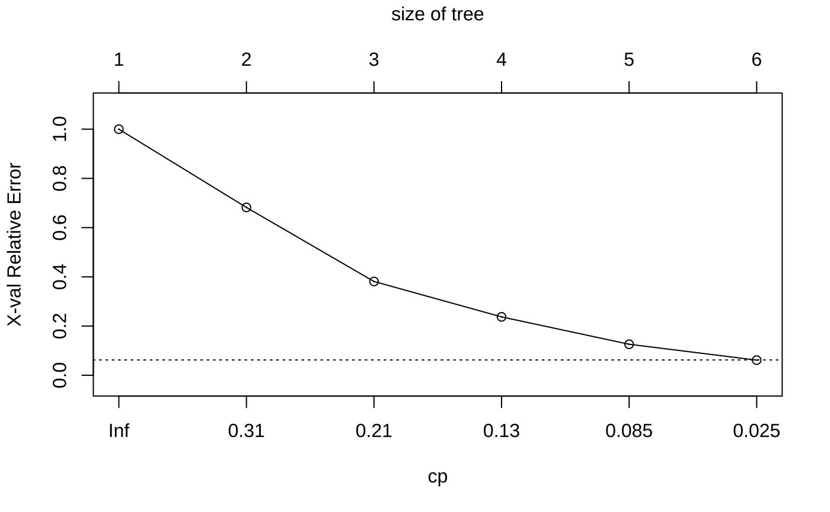
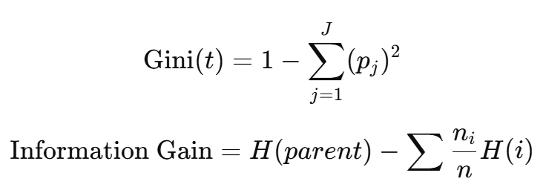
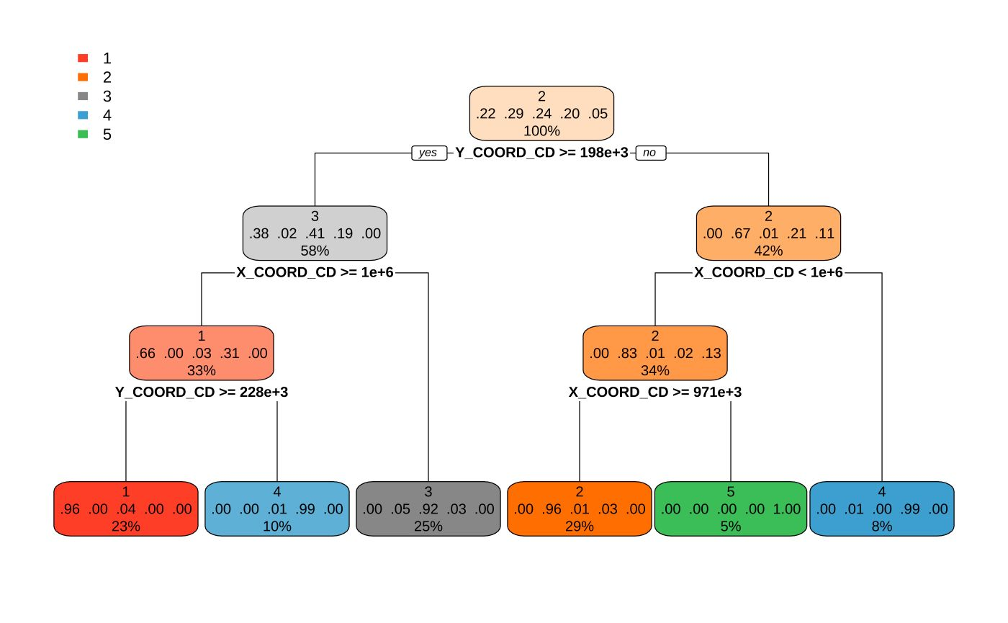
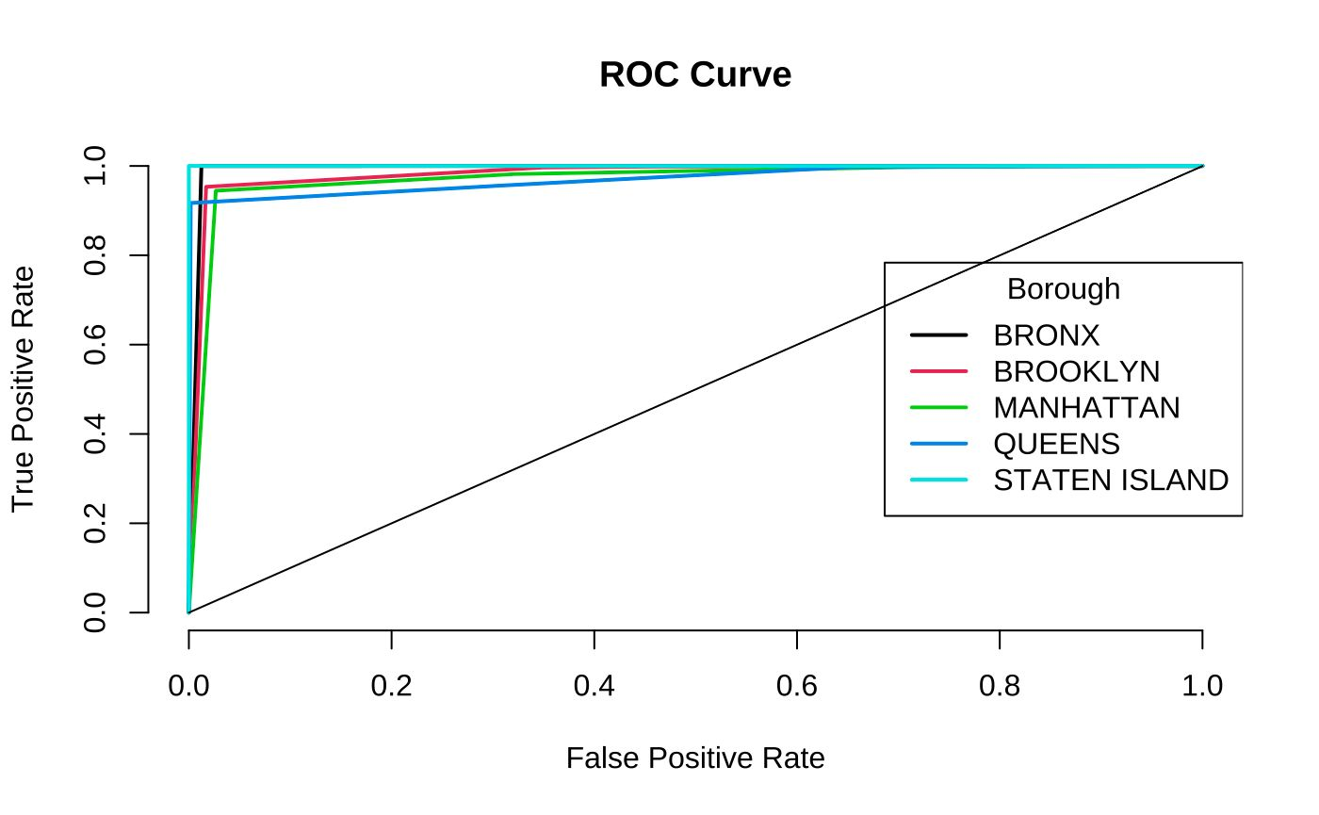
Model Training & Results
Logistic Regression, KNN, Decision Tree, SVM, Random Forest,
Decision Tree
Statistical Insights
Results
Tree-based model that splits features based on criteria like Gini or Entropy.
Non-linear and interpretable.
High variance model if unpruned.
Performs well on complex datasets.
Sensitive to small data changes
Train Accuracy | 95.66%
Test Accuracy | 95.66%
Runtime | Low
Model generalizes well
Smooth transition
Consistency Across Boroughs
No Overfitting
Lowest cross-validation error (0.025) occurs at tree size = 6, suggesting this is the ideal depth
Smaller tree => underfitting (higher error)

Slide 12
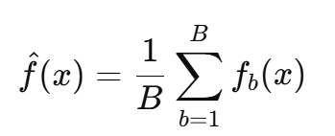
Model Training & Results
Logistic Regression, KNN, Decision Tree, SVM, Random Forest
Random Forest
Results
Ensemble of decision trees using bagging (bootstrap aggregation).
Reduces overfitting and variance..
Train Accuracy | 99.87%
Test Accuracy | 99.24%
Runtime | Very Low
No Overfitting
Robustness
Efficient
Statistical Insights
Low bias, low variance ensemble model.
Handles multicollinearity & missing data.
Robust against overfitting due to averaging.

Slide 13
AMS 597: STATISTICAL COMPUTING PROJECT
THANK YOU

